Slide 1
Claim Drafting Strategies
October 12, 2023 | Ryan Heck and Kyle Rinehart

Slide 2
What Makes a Claim Valuable?
Consider various factors when drafting claims.
Factor | Challenge | Goal (?)
infringement mapping | survive SJ motion for N/I | compelling mapping for direct infringement
distinctions from prior art | survive IPR | compelling distinctions
§112 position | survive SJ motions for §112(a), §112(b) | clear support; particular solution
§101 position | survive motion to dismiss | good technical theme
difficulty of design around | increase damages, create injunction risk | difficult to design around
ease of detectability | connect claim to target; find evidence of infringement | documentation for target entity is available

Slide 3
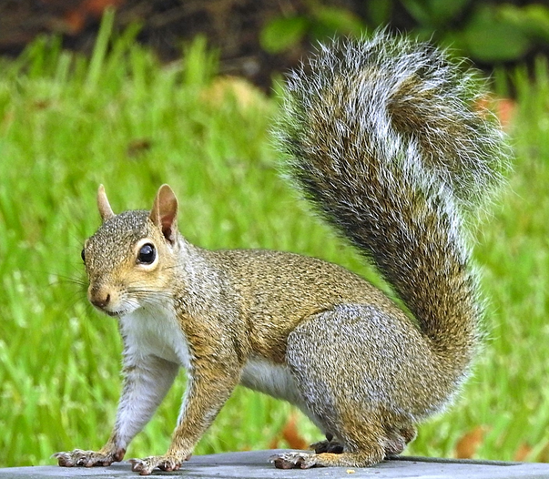
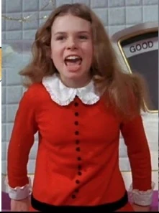
Why Can't I Have Everything?
A simple framework for this presentation.
Is it possible to maximize scores for a claim for all factors?
Yes….
Factor | Score
infringement mapping | 1.0
distinctions from prior art | 1.0
§112 position | 1.0
§101 position | 1.0
difficulty of design around | 1.0
ease of detectability | 1.0
But a zero for any score means failure.
Overall score: 1.0 × 1.0 × 1.0 × 1.0 × 1.0 × 1.0 = 1.0

Slide 4

(Over)reactions
Does a clear claim with compelling distinctions from the prior art and explicit support have high value? Maybe. Maybe not.
As prosecutors, we tend to react to the latest scary §112(a) case, §112(b) case, or §101 case.
But not to patents lapsing because infringement is unlikely or not detectable.
Factor | Score
infringement mapping | ?
distinctions from prior art | 1.0
§112 position | 1.0
§101 position | 1.0
difficulty of design around | 1.0
ease of detectability | 1.0
Overall score: ? × 1.0 × 1.0 × 1.0 × 1.0 × 1.0 = ?

Slide 5

But What If We Do This?
Suppose:
  spec describes A+B+C+D
  a claim for A+C+D probably covers a target entity.
Take a chance on
§112(a) support to
cover target?
Factor | Score
infringement mapping | 0.8
distinctions from prior art | 1.0
§112 position | 0.8 to 1.0
§101 position | 1.0
difficulty of design around | 1.0
ease of detectability | 1.0
Overall score: 0.8 × 1.0 × 0.8 × 1.0 × 1.0 × 1.0 = 0.64

Slide 6

The Eye of the Beholder
As a strategy, should we try to preserve options about claim scope?
  Use coined terms?
  Use terms without
  explicit support
  in the spec?
  Deliberately invoke
  §112(f)?
Factor | Score
infringement mapping | 0.0 to 1.0
distinctions from prior art | 0.0 to 1.0
§112 position | 0.0 to 0.5
§101 position | 0.0 to 1.0
difficulty of design around | 1.0
ease of detectability | 0.0 to 1.0
Overall score: ???

Slide 7

What Makes a Claim Valuable?
Consider taking “smart” chances on some factors to improve other factors.
Consider, at key times during prosecution (e.g., when filing a continuation, when filing an RCE), asking the client or inventors about factors that are “outside the file”
  infringement targets
  making claim harder to design around
Look for win-win opportunities
  use language with patentable weight but that is not required from direct infringer

Slide 8
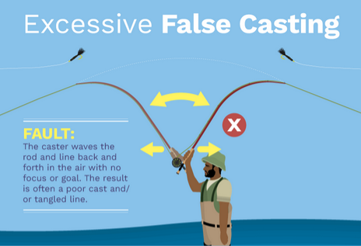
What Makes a Claim Valuable?
Recognize chances you are already taking during prosecution.
  Are you casting terms as elements that could instead be environment?
  Are you mindful of which limitations have patentable weight?
  Are you using language that requires multiple actors to infringe?
  Should you deliberately invoke 112(f)?
  Are you using the best claim formats for client?
  Are you using dependent claims effectively?
  Is claim compactness helping your cause?

Slide 9

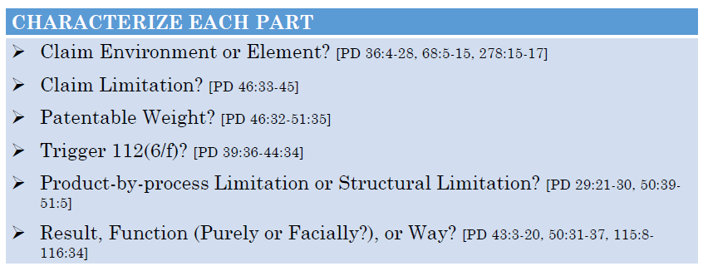
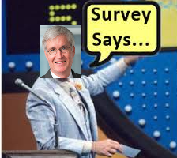
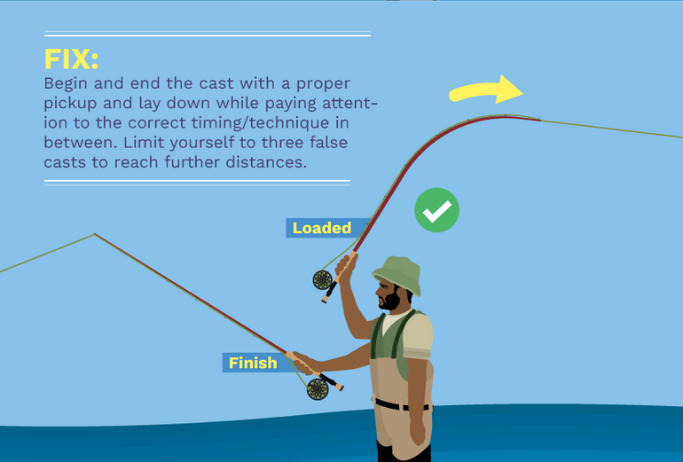
Claim Scope
Elements, Environment, and Limitations
Use strategically during prosecution
Consider during litigation

Slide 10

Definition Exposition
Infringement
  Claim elements
    Required to be shown as provided by a direct infringer.
  Claim environment
    Not required to be shown as provided a direct infringer.
    Variable degree of proof as to presence in environment:
      See INVT SPE LLC v. Int'l Trade Comm'n, 46 F.4th 1361 (Fed. Cir. 2022).
Validity
  Claim limitations
    Claim terms that “limit” the claim and are entitled to patentable weight
  Claim context
    Claim terms that are not entitled to patentable weight
      Maybe embrace terms that might be termed “limitations” in other contexts
        Product-by-process “limitations”
    May still be relevant to claim interpretation, definiteness, written description, help with claim clarity

Slide 11

No Patentable Weight – Claim “Context”
Preamble – intended use versus antecedent basis / “essential structure”
Printed matter / descriptive material – not entitled to patentable weight “if not functionally related to substrate”
Intended use / result
Optional / conditional language
Process portion of product-by-process claim

Slide 12

“Dialing In” Claim Language for Art and Infringement

Slide 13

Worst of Both Worlds
In determining validity of a product-by-process claim, the focus is on the product and not on the process of making it. …. That is because of the already described, long-standing rule that an old product is not patentable even if it is made by a new process. As a result, a product-by-process claim can be anticipated by a prior art product that does not adhere to the claim’s process limitation. In determining infringement of a product-by-process claim, however, the focus is on the process of making the product as much as it is on the product itself. … In other words, “process terms in product-by-process claims serve as limitations in determining infringement.” ... As a result, a product-by-process claim is not infringed by a product made by a process other than the one recited in the claim. Abbott v. Sandoz, 566 F.3d 1282 (Fed. Cir. 2009)
** ”[I]f the process by which a product is made imparts ‘structural and functional differences’ distinguishing the claimed product from the prior art, then those differences ‘are relevant as evidence of no anticipation’ although they ‘are not explicitly part of the claim.”

Slide 14
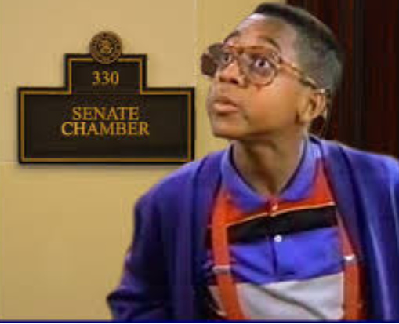
Opportunities and Unintended Consequence
a monolithic polymer structure being cast in one piece, the monolithic structure includes a flow tube and a cavity separated from the flow tube, wherein the flow tube defines a through-going straight flow section arranged for passage of a fluid between an inlet and an outlet, wherein a part of a wall of the flow section is part of an inside surface of the cavity, so that the flow section and the cavity has a shared wall area; and
Kamstrup A/S v. Axioma Metering UAB, No. 2021-1923 (Fed. Cir. Aug. 12, 2022)

Slide 15

Opportunities and Unintended Consequence
41. A communications device, comprising…
wherein the communications device is configured to…
transmit to an authenticating device of the communication network, the delivery confirmation message…
***
display at least a portion of content of the selected file or text message, wherein the authenticating device is configured to:
generate a delivery report that indicates a delivery event and a time of the delivery.”
JMOL finding of non-infringement based on failure to that show that the accused infringers provided the delivery report.
Argue that this was part of claim environment?
Intellectual Ventures I v. Motorola Mobility, 870 F.3d (Fed. Cir. 2017)

Slide 16
Claim Environment – Infringement
1. A plasticized soft tissue graft suitable for transplantation into a human, comprising:
a cleaned soft tissue graft having an internal matrix; and
one or more plasticizers contained in said internal matrix; said one or more plasticizers are not removed from said internal matrix of said plasticized soft tissue graft prior to transplantation into a human.
Language was added and argued in support of patentability
“This limitation is met without action by a third party. It is satisfied by the graft from the moment it is manufactured unless and until the plasticizer is removed from the internal matrix before transplantation.”
“Functional limitations recited in the negative may describe a capability or structural element.”
“The non-removal limitation simply provides a negative limitation that those plasticizers remain in the internal matrix prior to transplantation.”
Lifenet Health v. Lifecell Corp., No. 2015-1959 (Fed. Cir. Sept. 16, 2015)

Slide 17
Summit 6, LLC v. Samsung Electronics Co., 802 F.3d 1283 (2015)
1. A computer implemented method of pre-processing digital content in a client device for subsequent electronic publishing, comprising:
b. pre-processing said digital content at said client device in accordance with one or more pre-processing parameters, said one or more pre-processing parameters being provided to said client device from a device separate from said client device, said one or more pre-processing parameters controlling said client device in a placement of said digital content into a specified form in preparation for publication to one or more devices that are remote from a server device and said client device; and
Presence needs to be shown, but not by necessarily by the accused infringer during performance of the method.
“That the pre-processing parameters come from a second device is merely a characteristic of the parameters. It is not a step of the method, nor does it require current or ongoing activity.”
“That the pre-processing parameters are on the client device and that they have come from a second device must be proved, just like any other limitation. The claim term “being provided to,” however, does not limit the claim to the provision of pre-processing parameters only during the operation of the method.”

Slide 18
19. A remote registration station incorporating remote licensee unique ID generating means, said station forming part of a registration system for licensing execution of digital data in a use mode, said digital data executable on a platform, said system including
-licensee unique ID generating means…
-mode switching means operable on said platform which permits use of said digital data in said use mode on said platform only if a licensee unique ID generated by said local licensee unique ID generating means has matched a licensee unique ID generated by said remote licensee unique ID generating means; and
-wherein said remote licensee unique ID generating means comprises software executed on a platform which includes the algorithm utilized by said local licensee unique ID generating means to produce said licensee unique ID.
A “patentee can usually structure a claim to capture infringement by a ‘single party,’ by focusing on one entity.”
“This is exactly what Uniloc did in claim 19, which focuses exclusively on the ‘remote registration station,’ and defines the environment in which that registration must function.”
“That other parties are necessary to complete the environment in which the claimed element functions does not necessarily divide the infringement between the necessary parties.”
Uniloc USA, Inc. v. Microsoft Corp., 632 F.3d 1292 (Fed. Cir. 2011)

Slide 19
Question 1
A mechanical lock system comprising:
  a key having a unique X pattern;
  a lock having Y tumblers for engaging the key with the X pattern;
  a housing enclosing the lock;
  an actuator for engaging and disengaging the lock; and
  a user interface for operating the actuator.
X and Y are both claim elements, claim limitations, required for infringement and entitled to patentable weight
X and Y affirmatively define the structure of the key and the lock

Slide 20
Question 2
A mechanical lock system comprising:
  a key having a unique X pattern;
  a lock having Y tumblers produced using a process Z;
  a housing enclosing the lock;
  an actuator for engaging and disengaging the lock; and
  a user interface for operating the actuator.
X is a claim element, claim limitation, entitled to patentable weight, and required for infringement
Y is a claim element, claim limitation, entitled to patentable weight, and required for infringement
Z is a product by process claim limitation (could also be “context”), is not entitled to patentable weight, and is required for infringement

Slide 21
Question 3
A key comprising a unique X pattern and configured to open a lock having Y tumblers.
Characterization of X and Y?

Slide 22
Question 3
A key comprising unique X pattern and configured to open a lock having Y tumblers.
X is a claim element, claim limitation, required for infringement, and entitled to patentable weight.
Y defines an aspect of the claim environment and is not a claim element, need not be shown as provided directly by an accused infringer, is a claim limitation, and entitled to patentable weight.

Slide 23
Question 4
A mechanical lock system comprising:
a lock having a unique tumblers Y;
a housing enclosing the lock;
an actuator for engaging and disengaging the lock; and
a user interface for operating the actuator;
the lock being usable to engage a key having X pattern.
Characterization of X and Y?

Slide 24
Question 4
A mechanical lock system comprising:
a lock having a unique tumblers Y;
a housing enclosing the lock;
an actuator for engaging and disengaging the lock; and
a user interface for operating the actuator;
the lock being usable to engage a key having X pattern.
Y is a claim element, claim limitation, required for infringement, and entitled to patentable weight.
X at most defines a contextual aspect of the claim environment but is not a claim element or a limitation that provides patentable weight. It is merely a contextual statement of intended use. It provides no restriction on the lock or the lock system.

Slide 25
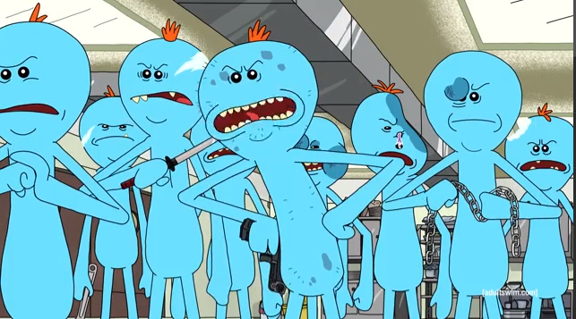
Multiple Actors: Madness in the Method
Goal: improve the strength of the mapping for direct infringement of a claim by a single target entity.
    In many cases, this can be done without weakening other factors.
    For some target entities, you may need to take chances.
  In general, direct infringement of a method claim requires that an entity perform (or direct or control another to perform) all steps of the claim.
    Single actor who performs all steps – simplest.
    Multi-actor – showing that the other entity is directed or controlled adds complication.

Slide 26
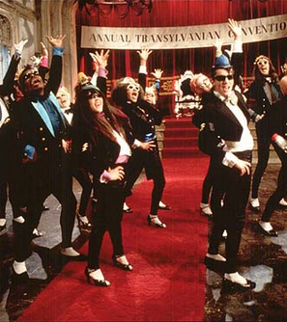
Multiple Actors:
Madness in the Method
Consider whether claim unnecessarily involves multiple actors.
Consider whether “best” single actor is targeted by the claim.
  A competing company directly infringes – yay!
  An end user directly infringes – hmm.
If possible, avoid requirements and limitations of contributory infringement or inducement.

Slide 27
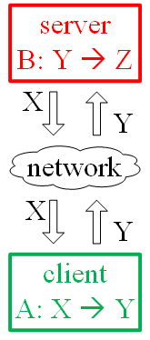
Multiple Actors: Common Example
Claim with Client-side Operations and Server-side Operations
In a computer system, a method comprising: with a server, sending data X over a network; with a client, receiving the data X; with the client, processing the data X with operation A, thereby producing data Y; with the client, sending the data Y over the network; with the server, receiving the data Y; and with the server, processing the data Y with operation B, thereby producing data Z.

Slide 28
Multiple Actors: Divide and Conquer
Split activity of different actors into different independent claims.
Claim with Server-side Operations | Claim with Client-side Operations
In a computer system, a method comprising: with a server, sending data X over a network to a client; with the server, receiving the data Y from the client; and with the server, processing the data Y with operation B, thereby producing data Z. | In a computer system, a method comprising: with a client, receiving data X from a server; with the client, processing the data X with operation A, thereby producing data Y; and with the client, sending the data Y over the network to the server.

Slide 29
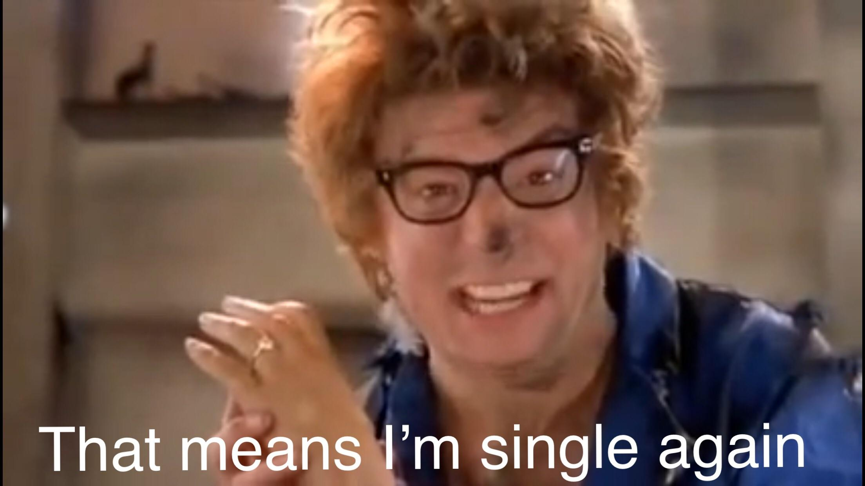
Multiple Actors: Wait a Tick...
Possible problems:
  Is there disconnect between elements of the claim covering server-side activity?
  What if the point of novelty is entirely with the client-side operation A? Do we have a problem with the claim that covers only server-side activity.
  What if the point of novelty is entirely with the server-side operation B? Do we have a problem with the claim that covers only client-side activity.
Maybe just focus on a single actor that avoids those problems?
Or perhaps take a chance in an independent claim....

Slide 30
Multiple Actors: Can We Do That?
Suppose point of novelty is entirely with the client-side operation A.
Pursue server-side claim that “reflects” client-side activity?
Claim with Server-side Operations | Claim with Server-side Operations
In a computer system, a method comprising: with a server, sending data X over a network to a client for use in processing with operation A [intended use?]; with the server, receiving data Y from the client, the data Y resulting from processing of the data X by the client with operation A [product-by-process?]; and with the server, processing data Y with operation B, thereby producing data Z. | In a computer system, a method comprising: with a server, sending data X over a network to an A-enabled client [point of novelty in environment language?], the data X being formatted to cause the A-enabled client to generate data Y [printed matter?]; with the server, receiving data Y from the A-enabled client; and with the server, processing the data Y with operation B, thereby producing data Z.

Slide 31
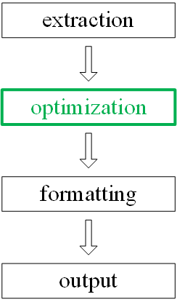
Multiple Actors: Where Else Are They?
Multi-actor issues are often flagged for actors at different locations, e.g., separated by a network.
Don’t forget multi-actor issues are possible for a complex system with multiple components, layers, etc. when different actors provide different components, layers, etc.
For a method claim, focus on operations performed using a single component, layer, etc. provided by the target entity.

Slide 32
Multiple Actors in System Claims?
In general, direct infringement of a non-method claim requires that a single entity make, use, sell, offer to sell, or import the completed combination of the claim.
  Entity that adds the final element to the claimed system infringes.
  Single actor who completes the claimed system – simplest? best for prior art? best for damages?
  Multi-actor –not recognized, except in limited circumstances.
Consider which target entity will “complete” the device or system.
  New gear for automobile transmission – claim gear?
  Claim transmission?
  Claim car?

Slide 33

Conditional Language: If … You Have to Ask
In general, an optional element does not narrow a claim because the element can be omitted.
A conditional step is performed “if” or “when” a condition precedent is satisfied.
  If the condition precedent is not satisfied, the step need not be performed.
  As a rule, a conditional step is not given weight towards patentability (and also is not required for infringement…).

Slide 34
Conditional Language: If … You Have to Ask
In some cases, patentability resides in selectively performing an operation.
Consider whether claim language has weight towards patentability.
  Needed to distinguish prior art?
  Needed for §112 support or §101 support?
Effect of different options to recast conditional language.
  Complicates infringement mapping?
  Makes design around easier?
  Difficult to detect?

Slide 35
Conditional Language: If … You Have to Ask
Suppose prior art shows performing operation A but not conditionally performing operation A depending on condition Y
Claim Language | Analysis
if condition Y is satisfied, performing operation A | not limiting; condition Y need not be satisfied
when condition Y is satisfied, performing operation A | limiting? same as "if..."? affirmative? even if language is limiting, prior art might show performance of operation A when (by coincidence) condition Y has been satisfied
add "selecting" step selecting between performing operation A and not performing operation A | the "selecting" step is limiting does "selecting" distinguish prior art? maybe detectability not hurt too much?

Slide 36
Conditional Language: If … You Have to Ask
Claim Language | Analysis
summary approach responsive to satisfaction of condition Y, performing operation A OR depending on whether or not condition Y is satisfied, conditionally performing operation A | arguably limiting even if limiting, prior art might show performance of operation A when (by coincidence) condition Y is needed before operation A can be performed evaluation step not required?
add "evaluating" step evaluating condition Y (or determining whether condition Y is satisfied); if (OR when) condition Y is satisfied (OR responsive to satisfaction of condition Y), performing operation A | the "evaluating" step is limiting does "evaluating" distinguish prior art? yes detectability may be more challenging because "evaluating" could be hidden the “if" or "when" term is still not limiting, but maybe that is OK

Slide 37
Conditional Language: If … You Have to Ask
Claim Language | Analysis
add "measure" and "threshold" determining a measure of Y-ness; and comparing the measure of Y-ness to a threshold; and responsive to the comparing, performing operation A | the "determining" and "comparing" steps are limiting do they distinguish prior art? yes detectability may be challenging, but may be difficult to prove in prior art too
cover both options responsive to satisfaction of condition Y for a first item, performing operation A responsive to condition Y not being satisfied for a second item, skipping operation A | prior art might show performance of operation A when (by coincidence) condition Y is needed before operation A can be performed, and skipping operation A otherwise infringement mapping and detectability might be unchanged, for practical purposes

Slide 38
§112(f): Functional Claiming Made Easy?
In general, when a claim term invokes §112(f), the claim term includes additional details from the specification – the corresponding structure, material, or acts (SMA).
Use §112(f) to improve the strength of:
  distinctions versus prior art
  §112 support or §101 support
  “survivability” of claim
But §112(f) invoking can:
  complicate the infringement mapping
  make infringement harder to detect

Slide 39

§112(f): Plead the (f)^{th}
So many questions.
  Is §112(f) invoked?
  What is the recited function?
  What is the corresponding SMA for the recited function?
  Is there clear linkage between the recited function and corresponding SMA?
  What are the structural equivalents?
Many questions about claim scope.

Slide 40
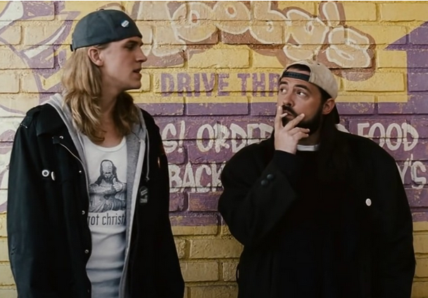
§112(f): You Have the Right To Remain Silent
Lean in / remove uncertainty about invocation of §112(f)?
  Use classic formulation (means for ___, step for ___).
  Provide clear linkage in the specification or file history.
  Selectively “bail out” later on by adding SMA sufficient to perform recited function directly in claim?
Preserve the option to invoke §112(f) during litigation?
  Use a nonce word (unit, component, module, logic, ___-er).
  Include some SMA to perform recited function in claim. Sufficient?
Try to avoid invocation of §112(f)?
  Use term that has a definite meaning to a POSITA as the name of a structure or step.
  Include more SMA to perform recited function in claim.

Slide 41
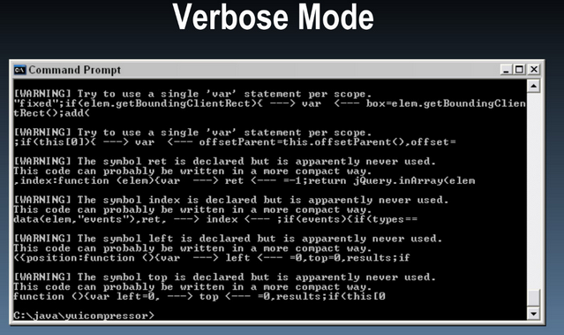
Concise Claim Versus Verbose Claim
  Consider two claims that have similar scope.
  Why write a claim that may be hard to read?
    Pro:
      Psychological effect on the examiner
        May look more impressive, narrow – examiner less inclined apply knee-jerk rejections (§ 101 or art) based on perceived breadth.
      May make it harder for the examiner to apply “sloppy” rejections.
      Examiner “fatigue.”
      May preserve breadth and reduce estoppel.
    Con:
      § 112 issues, such as antecedent basis.
      Explaining the claim to a judge or jury (or client).
  How to increase verbosity.
    Unpack “plurality,” unpack terms - definitions.
    Pedantic use of antecedent basis.
    Negative claim limitations.
      “Narrow” == “Broad”
      Heightened support requirement?

Slide 42

Concise Claim
A shopping method, comprising:
approaching a plurality of vendors at a market;
for each vendor of the plurality of vendors:
determining a type of fruit the vendor sells from a list of fruits;
asking for the price of the type fruit based on the vendor’s pricing list;
purchasing the type of fruit; and
receiving the type of fruit from the vendor.

Slide 43

A shopping method, comprising:
approaching a first vendor at a market;
determining from a first list of fruits for the first vendor that the first vendor sells a first fruit type;
asking the first vendor the price of the first fruit type, the price of the first fruit type being based on a pricing list for the first vendor, the first pricing list comprising a first price for the first fruit type;
purchasing one or more fruits of the first fruit type from the first vendor according to the price of the first fruit type in the first pricing list;
receiving the one or more fruits of the first fruit type from the first vendor;
approaching a second vendor at the market, the second vendor being different than the first vendor;
determining from a second list of fruits for the second vendor that the second vendor sells a second fruit type, wherein the second fruit type is the first fruit type or is a fruit type other than the first fruit type;
asking the second for the price of the second fruit type, the price of the second fruit type being based a second pricing list comprising a price for the second fruit type, wherein, when the second fruit type is the first fruit type, the second price is the first price or is a price other than the first price;
purchasing one or more fruits of the second fruit type from the second vendor; and
receiving the one or more fruits of the second fruit type from the second vendor.

Slide 44
Claim Formats: Best Options for Client?
 | Method | Device / System | Manufacture / CRM
which entity directly infringes? | competitor? end user? potential customer? | more likely to cover competitor | more likely to cover competitor
what activities are covered? | use / perform method | make, use, sell, offer to sell, or import | make, use, sell, offer to sell, or import
how easy is it to detect infringing activity? | infringing activity may be more difficult to detect (e.g., end user activity, manufacturing behind the scenes) | infringing activity may be easier to detect (“configured to,” “capable of” language) | infringing activity may be easier to detect (“configured to,” “capable of” language)
marking required? | not required if only method claims asserted | §287 marking requirements apply | §287 marking requirements apply

Slide 45

Dependent Claims
Consider value
  Listing narrowing features that may not distinguish art?
  Including definitional information that is arguably in independent claims?
  Including features that might point out deficiencies in independent claim – definiteness, functionality, patent ineligible subject matter?
Take a chance?
  Move between claim element and environment, limitation and context.
  Add explicit means plus function language.
  Change nature of conditional language?
  Add clarifying/definitional information to hedge your “chances”?
    But see above.

Slide 46
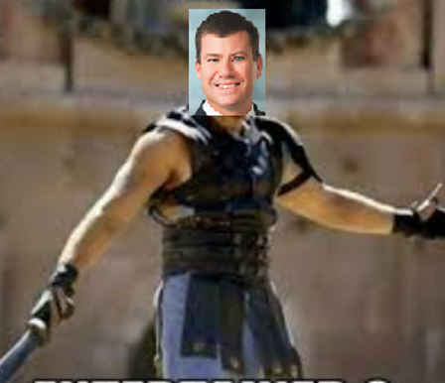
Are You
Not Entertained?

